Slide 1

Southern Nevada Lived X Team
2024
ANNUAL REPORT
Led by Experience, Driven by Purpose
August 2025

Slide 2


About Us
Mission Statement
It is our mission to promote a community-wide commitment to ending homelessness. Through the collaborative efforts of people with lived experience of homelessness, nonprofit providers, and state, federal, and local government, we unite community resources to provide comprehensive support and services for people experiencing homelessness, and those on the brink of homelessness, ensuring a coordinated and holistic approach to address their individualized needs.
Vision Statement
Southern Nevada Lived X envisions a compassionate and empathetic community where the stigma surrounding homelessness is eradicated through education, understanding, and shared experiences.

Slide 3

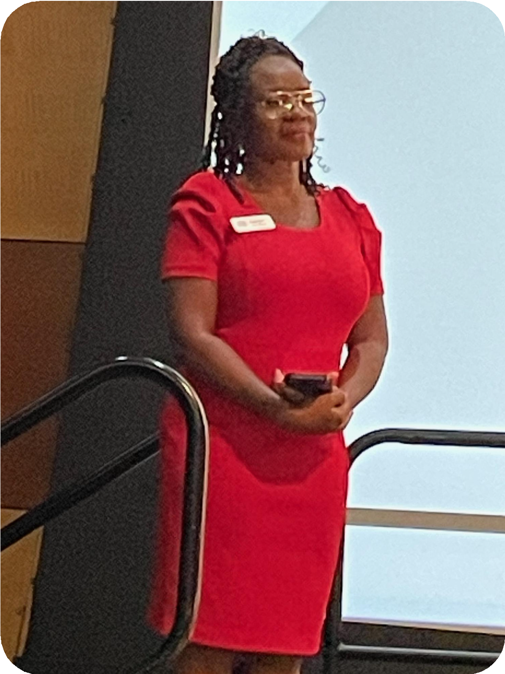

Our Fearless Leader
Since the inception of Lived X in the summer of 2022, Dr. Catrina Grigsby-Thedford has been a steadfast pillar and guiding light. With deep compassion and unwavering commitment, she brought together a team of individuals with recent lived experience of homelessness, while another group supported by HUD TA was forming that included Operation HOME staff with histories of housing instability.
Through Dr. Catrina’s vision, leadership, and collaborative spirit, these two groups came together, creating the Southern Nevada Lived X Consultants which is now known as the Lived X Team.
Her dedication has gone far beyond assembling a team. Dr. Catrina has invested countless hours, leading an ever-expanding portfolio of impactful projects, and leveraging her extensive community relationships to ensure that people with lived expertise are not only included but fully integrated and valued within systems across Nevada.
With grace, passion, and tireless advocacy, she has nurtured leadership in others, amplifying the voices of those too often overlooked or forgotten. Simply put, the Lived X Team would not exist without her compassionate and Fearless Leadership
We thank you for your unwavering commitment
-Lived X.

Slide 4

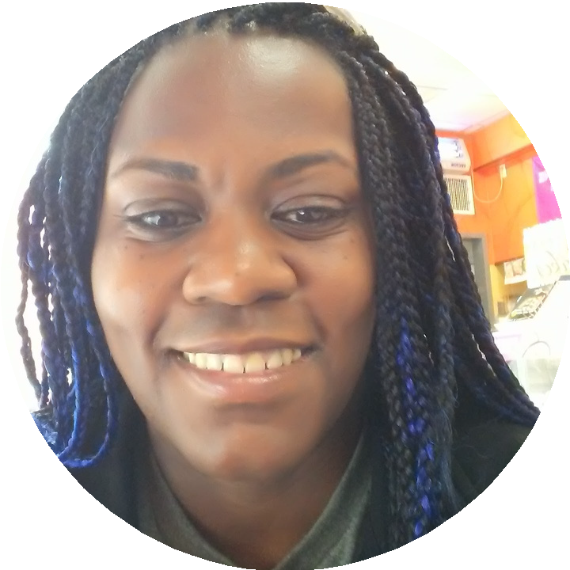
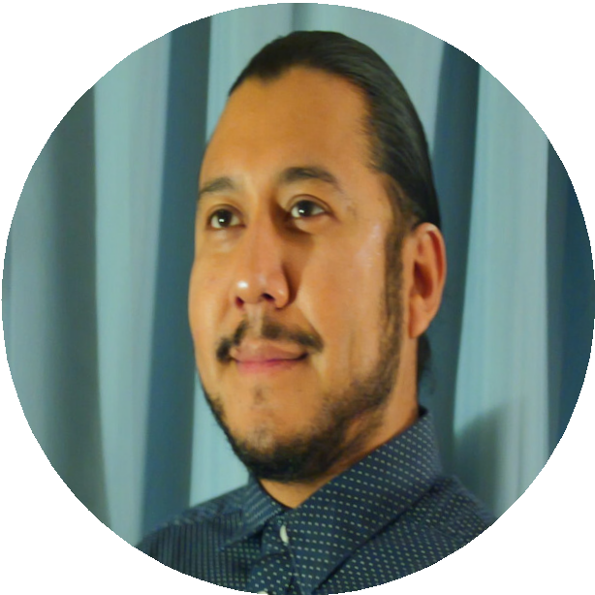
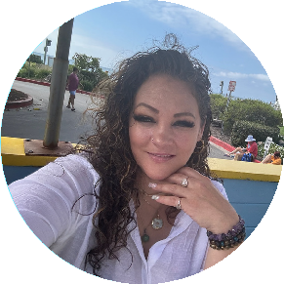
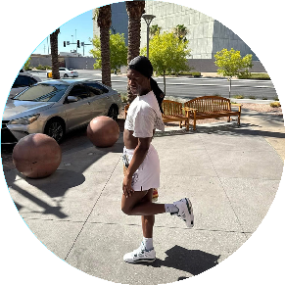


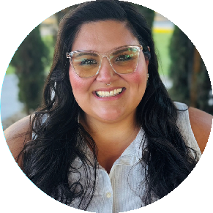

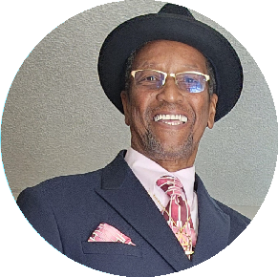
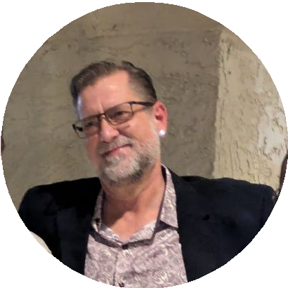
OUR TEAM
EST. 2022
Tamika Edwards
Martin Castro
Donica Martinez
Davion Taylor
Amy Jones
Alejandra Holmes
Keasia Braggs
Dargin T. McWhorter
Louis Hixson

Slide 5

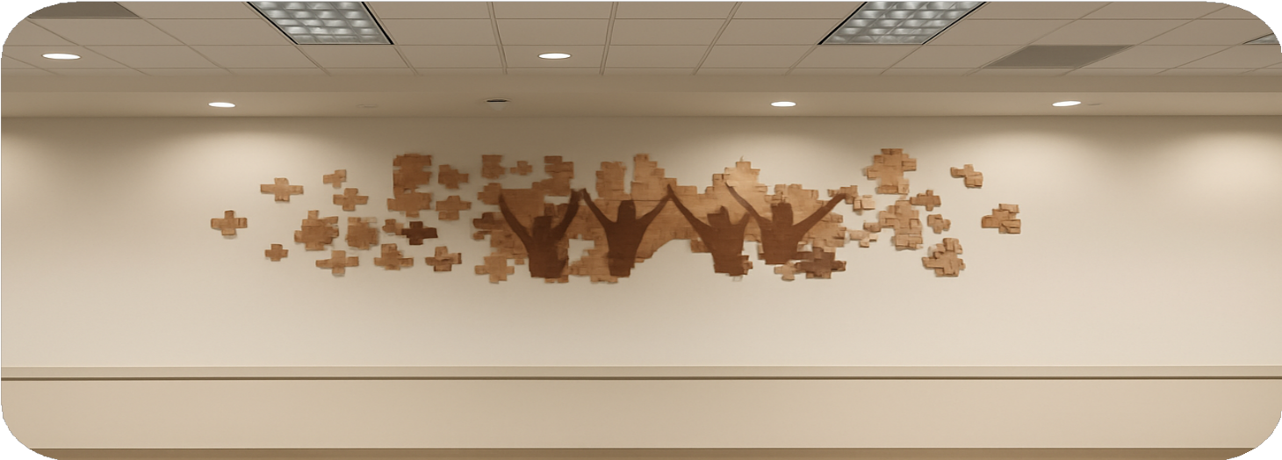
Our Southern Nevada Lived X Team helps complete the puzzle.
We’re committed to showing up for people with lived and shared experiences and making sure their voices are part of the bigger picture.

Slide 6

YEAR IN REVIEW
26
Completed
12
Ongoing
39
REQUESTS RECEIVED
10 Clark County Social Service
74%
Local Requests
1 Request for Resources
This is a 77.27% increase from 2023!

Slide 7
2024 Overview

Slide 8







Project Highlights
SNH CoC governing board and committees Scoring and Ranking Team 2024
Academy 101
Facilitate HPS Trainings
Participate in local, state, and national Initiatives Unsheltered Surveys
Woodwell Climate Research Center
Youth Experiencing Homelessness Steering Committee SEI Youth Study Design Team
Late 2023 >> Study Design >> Completion 2025 Northern Nevada CoC Lived Experience Advisory Board Facilitate Trainings and assist with the Youth Action Board Nevada Youth Experiencing Homelessness Study Northern Nevada CoC Leadership Council’s L.E.A.B.

Slide 9

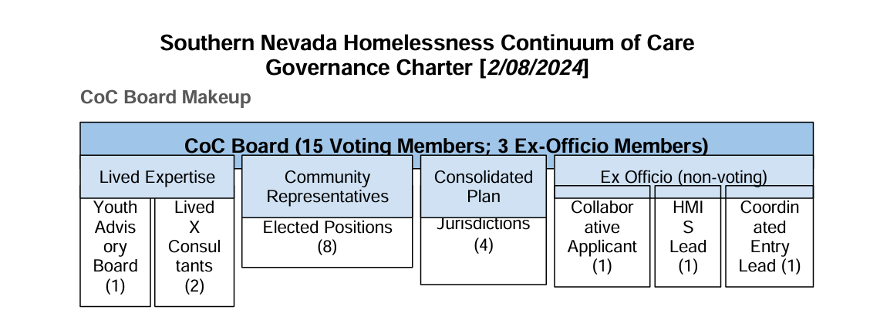
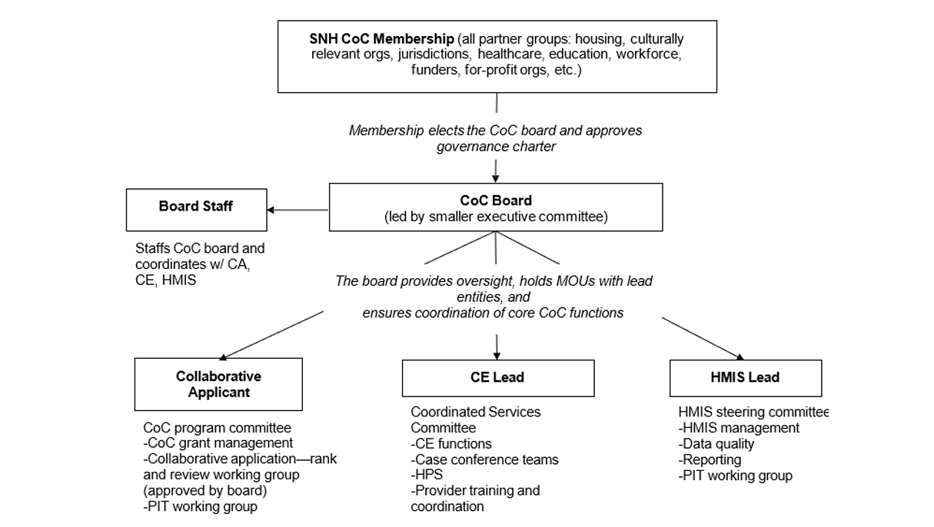
SNH CoC
Governing Board & Committees
Our Co-PLE Coordinators sit on the SNV CoC Board
Many of our Lived X Team members are a part of the CoC’s membership through the respective organization they work for. We have 1 member on the CoC Programs Committee, 2 members on the HMIS Steering Committee, and 3 members on the Coordinated Services Committee

Slide 10

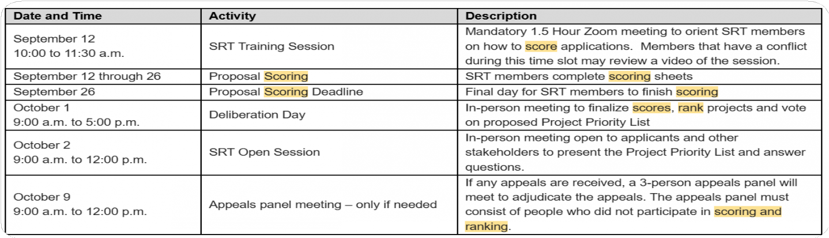


Scoring & Ranking Team 2024
One of our Lived X Team members joined the Scoring and Ranking Team with EdeColigny Consulting LLC contracted by Clark County Social Services Resource And Development.
As a member of the team, they participated in the
consolidated application process, scored submitted applications, and ranked them accordingly.

Slide 11

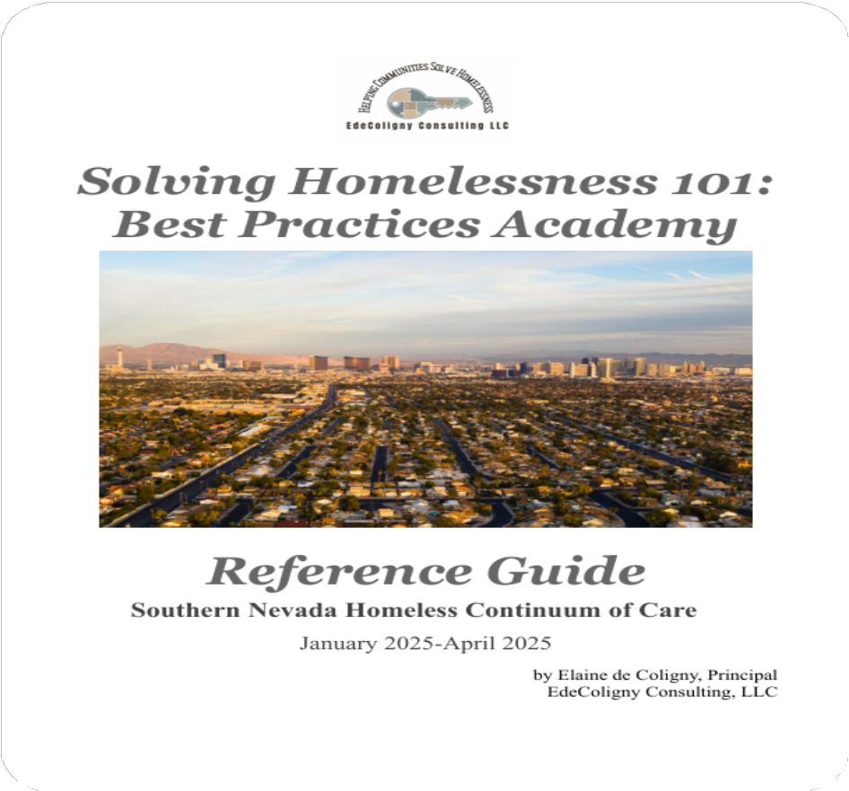
Academy 101
EdeColigigny Consulting LLC
To create Academy 101, Elaine de Coligny and her team along with Donica Martinez gathered the experiences of people in different stages of their homelessness. During this process, Donica guided Elaine into the tunnels and provided space for her to conduct interviews. Additional members of the Lived X Team contributed their expertise in this amazing 25 hour training course as well.

Slide 12

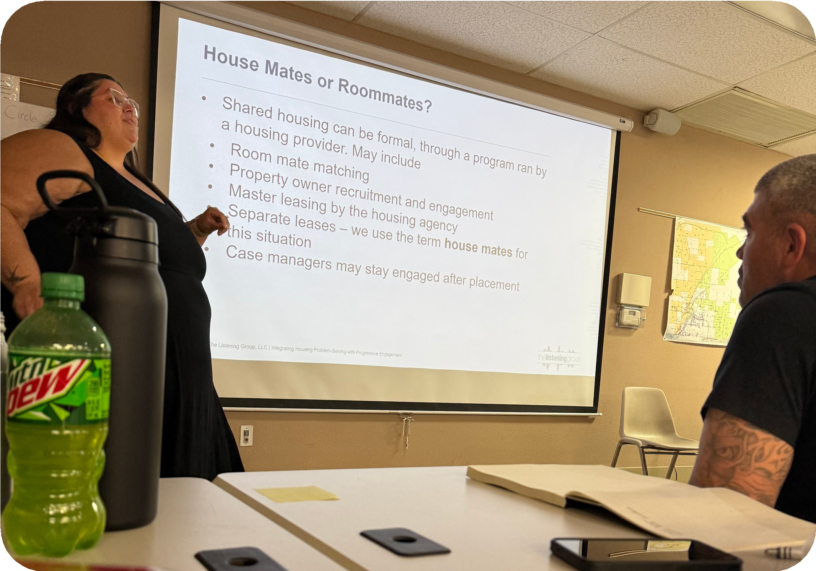
Facilitated Housing Problem Solving (HPS) Training
In 2024, we led HPS trainings for partner agencies across Clark County, equipping frontline staff with tools to support client-centered housing solutions.
Our sessions emphasized practical strategies, resource navigation, and collaborative problem-solving to prevent homelessness and promote housing stability.

Slide 13

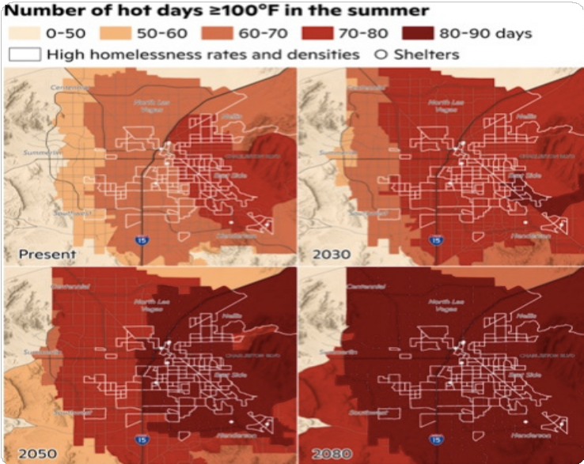
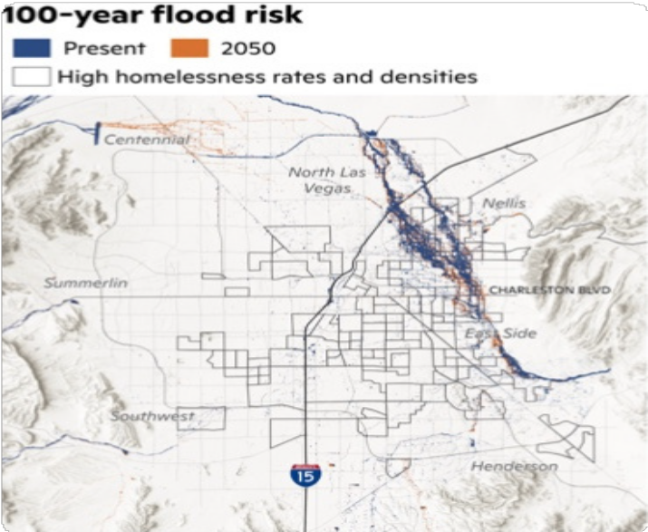
Woodwell Climate Research Center
Since 2023, the Southern Nevada Lived X Team has partnered with the Woodwell Climate Research Center to support critical research on the intersection of extreme heat and homelessness. Our team contributed to a regional heat map analysis while providing ongoing first-hand, anecdotal data on the lived experiences of unsheltered individuals during extreme weather events. These narratives have played a key role in shaping a deeper understanding of climate vulnerability. The findings from this collaborative project was formally published in July 2025, offering a compelling look at how climate change directly impacts some of our most marginalized community members.

Slide 14

Youth Experiencing Homelessness (YEH) Steering Committee
In 2023, the Nevada Department of Health and Human Services funded a two-year, exploratory study to better understand the prevalence, characteristics, and needs of youth at risk of or experiencing homelessness.

Slide 15


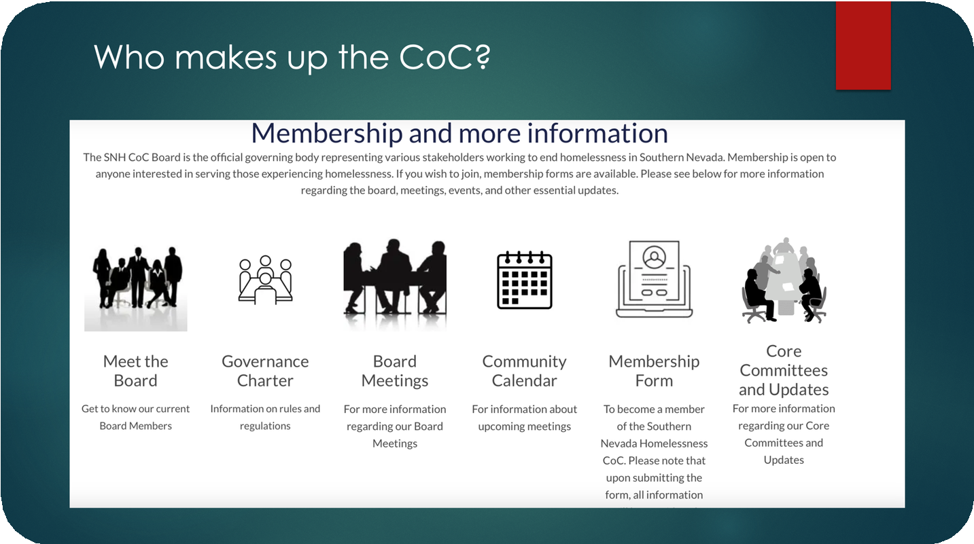
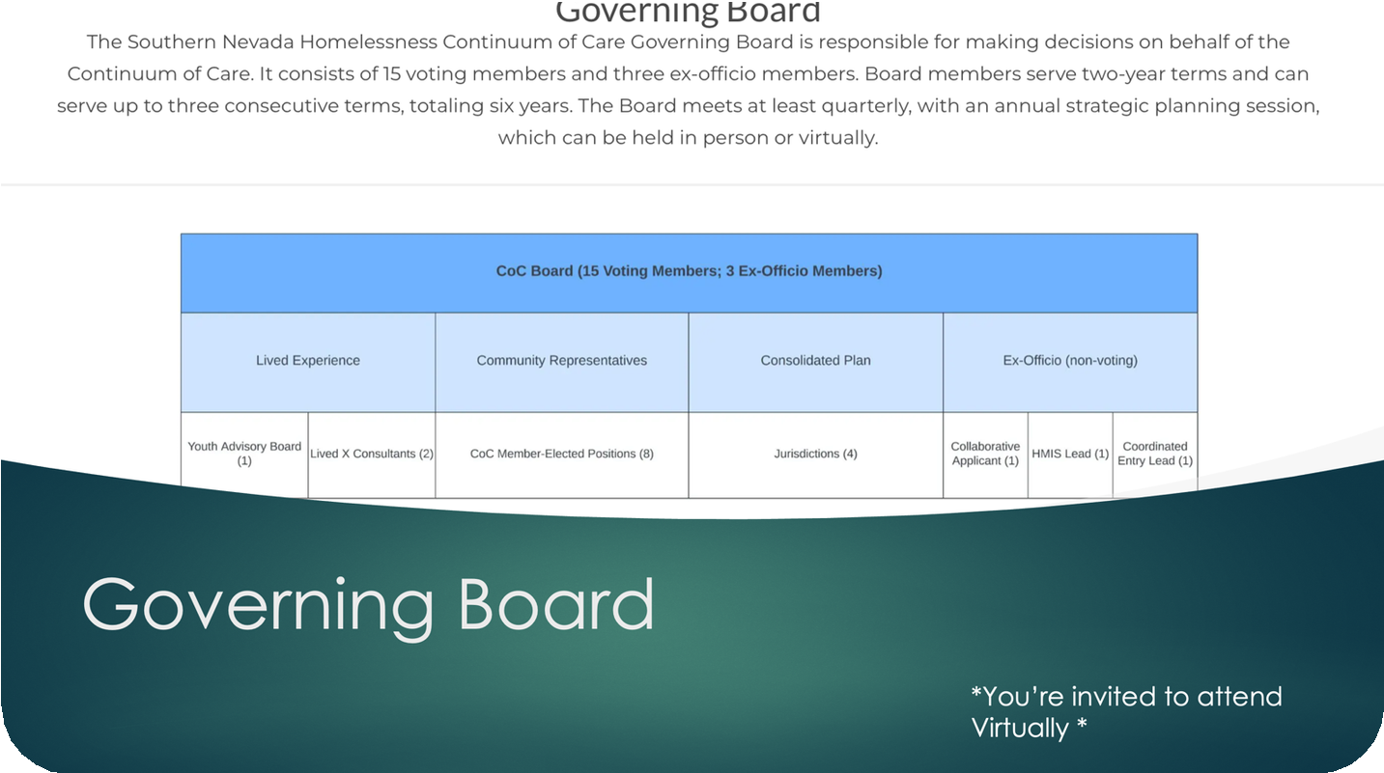
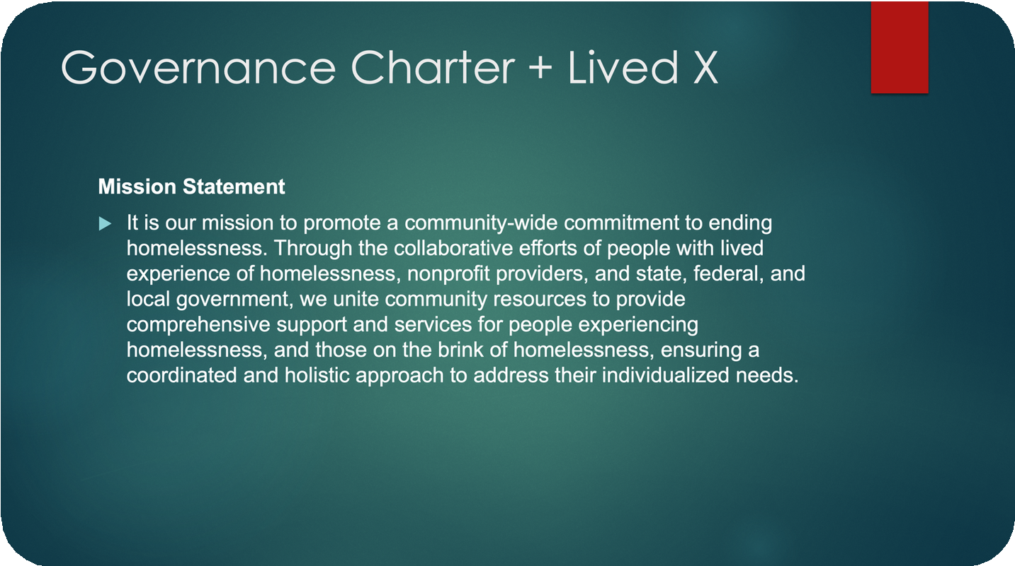
Training Facilitation With Youth Action Board
Four members of the Lived X Team met with the Youth Action Board to discuss:
What is a CoC? (Purpose, HUD role, structure)
Overview of Southern Nevada’s Homeless Response System Youth Homelessness Demonstrated Program (YHDP)
Role of YAB within the CoC
Systems change, advocacy, accountability

Slide 16

Nevada Youth Experiencing Homelessness Study 2023-2025
In 2024, our Lived X Team was proud to contribute to the Nevada Youth Experiencing Homelessness Study (2023–2025), led by Kim Hopkinson, PhD (she/her), Principal, Social Entrepreneurs, Inc. By sharing our insights and lived expertise, we helped ensure that the voices of youth and those on the frontlines of service delivery were reflected in the research.
This collaborative effort alongside state partners, providers, and community members highlights the power of centering real experiences to guide meaningful change. The study’s findings offer a roadmap for strengthening support systems and improving outcomes for youth experiencing homelessness across Nevada.
To view the full report, visit www.nevadahomelessalliance.org/livedx

Slide 17


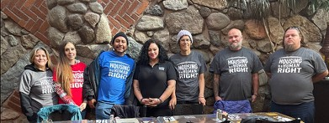
Focus Groups with Washoe County Lived Experience Advisory Board (LEAB)
Two Consultants assisted the Washoe County Lived Experience Advisory Board in conducting focus groups to gauge the understanding of Coordinated Entry within the community and its providers
The project began in October 2023 and was completed in April 2024
LEAB presented their findings on different platforms, agencies, and were absorbed into the Washoe County direct projects

Slide 18

Unsheltered Survey
The Lived X Team created a survey for people experiencing unsheltered homelessness that was first implemented during the Project Homeless Connect on November 21, 2023. The Team was able to survey 241 individuals. Here are the findings:
Length of Time Homeless
10+ yrs
11.7%
3-6 months
13.1%
7-10 yrs
2.8%
5-7 yrs
7.9%
6-12 months
17.3%
3-5 yrs
16.8%
1-3 yrs
30.4%

Slide 19


AGE
Skipped 16.2%
18-24
1.2%
25-34
13.7%
65+
6.2%
35-44
23.2%
55-64
20.7%
Race/Ethnicity
Other
45-54
18.7%
Multi Racial 28
3
American Indian/Alaskan Native 6
White/Caucasian 79
200
Asian/AA 6
150
Hispanic/Latino 38
Gender
100
Black/AA 73
50
0
Female
Male
Trans-Male
Other
Trans-Female
Prefer not to say
Gender Variant / Non-Conforming

Slide 20
What services do you feel are missing in the community?
Transportation 1
0.4%
Resources 15
5.3%
Mental Health 4
1.4%
Shelters for Individuals 29 10.2%
Shelters for ind. with pets 4 1.4%
DV shelters 2
0.7%
Skipped 39
13.7%
Housing 63
22.1%
I don't know 5.3%
Resource Events 15
5.3%
Knowledge of Resources 16
5.6%
Outreach 14
4.9%

Slide 21
What can our Community do better at?
Skipped 25
9%
Communication 1.8%
I don't know 3.2%
Funding 1.1%
Housing 14
5%
Shelters 11
4%
Empathy/Caring 75
27%
Outreach 20
7.2%
Transportation 9
3.2%
Legal/Immigration Assistance 7
2.5%
Resources/Services 22
7.9%
Community Unity 43
15.5%

Slide 22
What one thing do you believe could end homelessness right now?
70
60
50
40
30
20
10
0
None 5
Day Care 0
Other 54
Shelters 6
Funding 11
Advocacy 4
Empathy 1
Resources 12
Spirituality 2
Education 1
Employment 54
Transportation 5
Mental Health 3
Crisis Services 6
Immigration 1
Legal Assistance 8
Detox/Treatment 5
Support System 18
Community Unity 18
Affordable Housing 61
Recovery Support 10
2nd Chance Employment 4

Slide 23


Honoring Our Neighbors
This list is more than just names it is a tapestry of lives, of stories, of souls who mattered deeply to someone, somewhere, and to us all as a community. Each name here represents a person who walked this Earth with purpose, dreams, struggles, and love. They were fathers and mothers, brothers and sisters, sons and daughters. They were friends, mentors, advocates, artists, workers, dreamers, survivors, and neighbors.
Some offered guidance and wisdom; others inspired joy through their laughter and light. Many faced hardship and adversity with quiet resilience, and some left us far too soon. Yet all, every single one of them, left a mark on the world around them.
As we reflect on these names, we honor not just their memories but the humanity they carried. We recognize the shared experiences that bind us together love, loss, triumph, and pain and we affirm our commitment to never forget those whose lives might otherwise be overlooked.
We say their names aloud because they deserve to be remembered.
We write their names down because their stories matter.
We lift up their memories as a reminder of the sacredness of every life.
This is our call to compassion, to justice, to community to ensure that those who have passed are never invisible, and that those still here know they are not alone.
To all the beloved neighbors represented here: We remember you. We miss you. We honor you.
May your memories be a blessing, and may your legacies live on in the work we do, the lives we serve, and the love we carry forward in your name.
To Aaron, Alyssa, Clifford, Diana, Enrique, Jasmine, Lamar, Nycole, Terrence, and Zachariah your names are more than just letters on a page. They are echoes of stories, moments, and memories that still live in the hearts of those who knew you.
In 2024, we lost 350 of our unhoused neighbors in Las Vegas.
You were among them, but you were never anonymous. You were part of the fabric of this community, and your presence made it stronger, richer, more human.
We remember you.
We speak your names with love. And we carry your light forward.

Slide 24

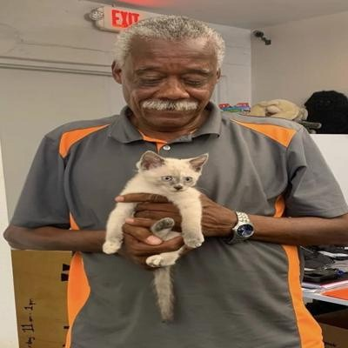

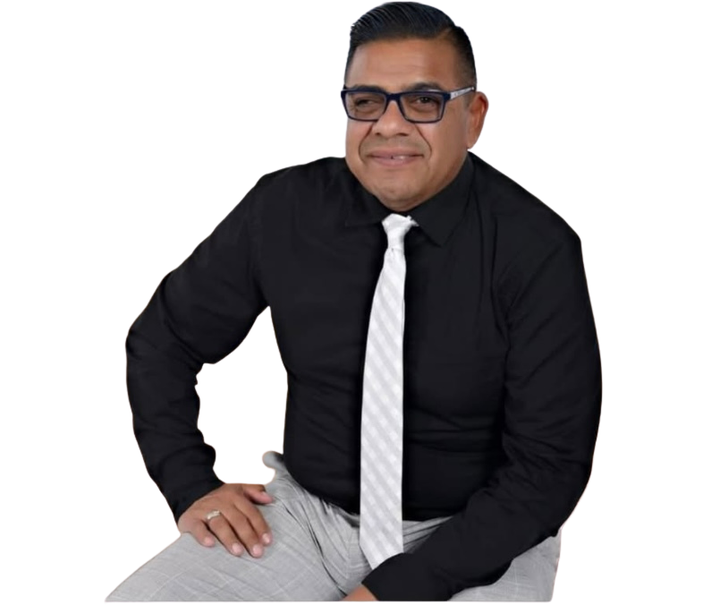


In Loving Memory
In loving memory of Harvey Austin, our longtime volunteer care coordinator at The CARE Complex, whose unwavering dedication and compassion profoundly impacted our community. Harvey's heartfelt commitment to serving others continues to inspire us all.
Juan Salinas
November 25, 1964- February 2, 2024
Juan Salinas' passing is a profound loss, not only for The Salvation Army but for the entire community. His unwavering commitment to equality for the LGBTQIA+ community created lasting change and a safer, more inclusive space for those in need. Juan’s legacy of compassion and advocacy will continue to inspire us to uplift and protect the most vulnerable among us.
In Loving Memory of Anthony James Phillips
August 15, 1977 – February 14, 2025 Anthony James Phillips was a founding force
behind Street Dogz, helping grow the organization from a small idea into a vital community resource. His vision, generosity, and commitment to service shaped its mission and impact across Nevada. He will be deeply missed and forever remembered.

Slide 25
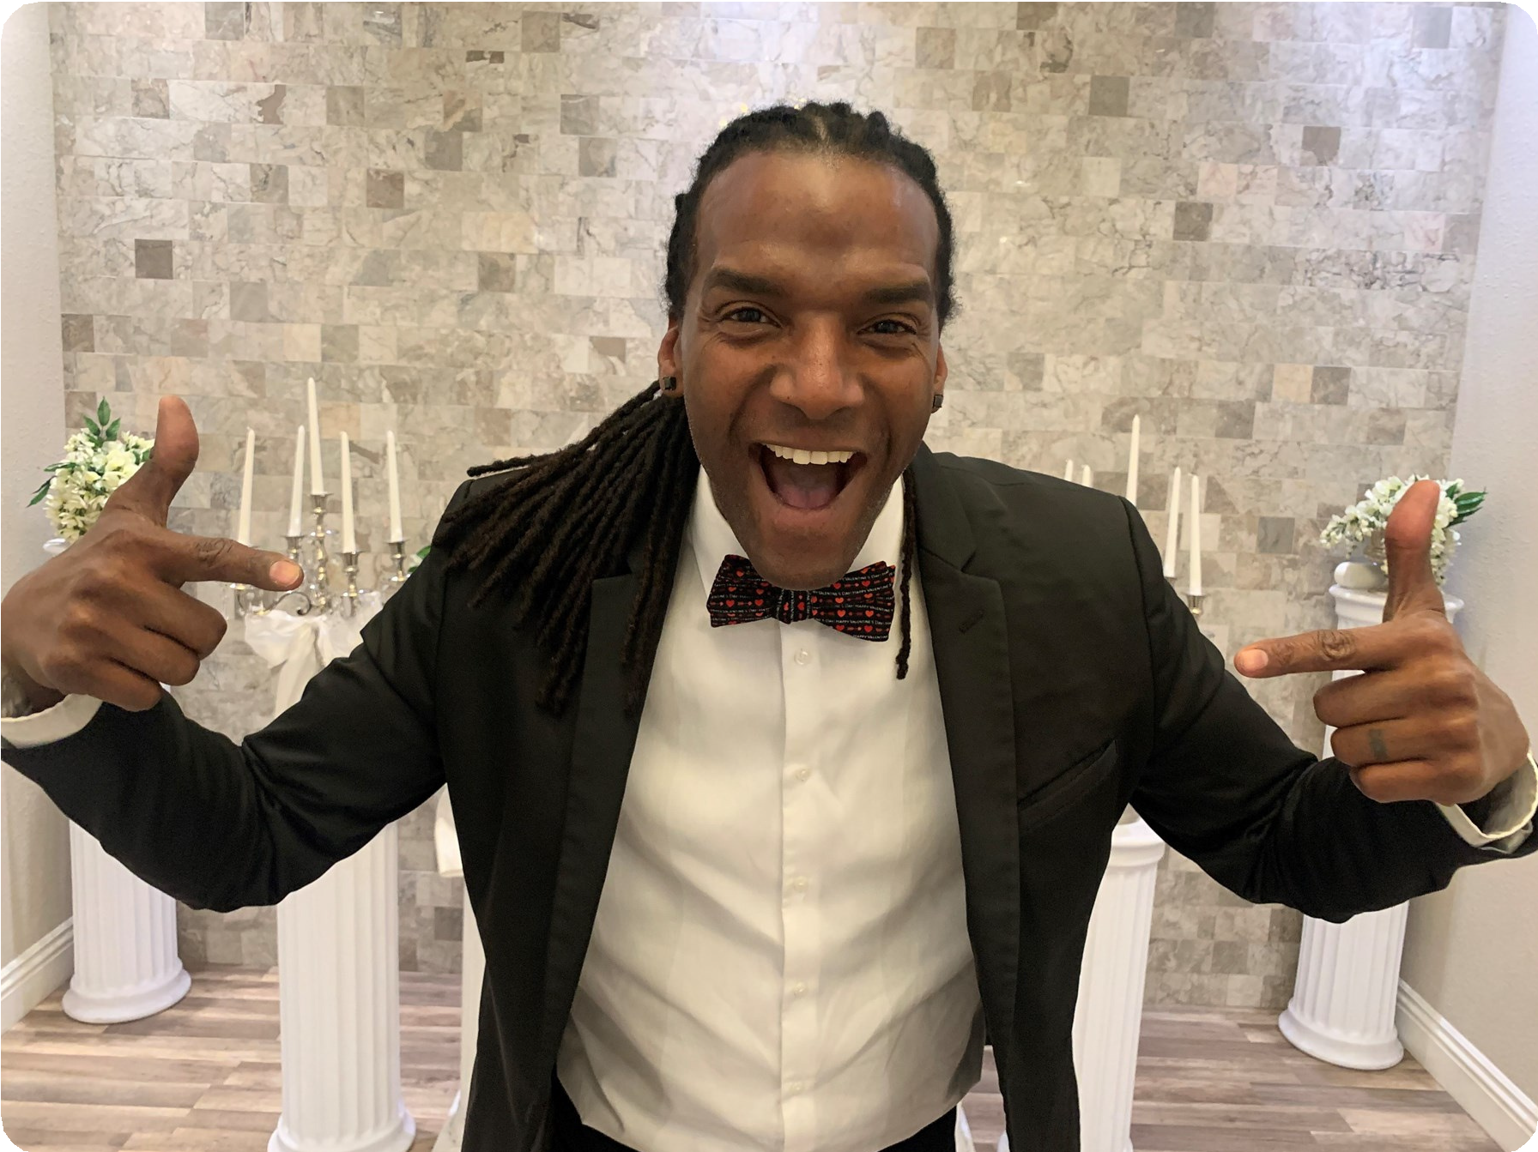
In Loving Memory
In Loving Memory of Pastor Henry Darnell Sneed
August 27, 1967 – July 9, 2024
With heavy hearts and profound respect, we remember and honor the life of Pastor Henry Darnell Sneed, our beloved NHA board member, who transitioned from this life on July 9, 2024. Pastor Sneed was more than a title he was a beacon of light, a steadfast guide, and a source of strength for all who had the privilege of knowing him.
A devoted husband, father, pastor, and life coach, Pastor Sneed lived with purpose and walked in faith. His wisdom reached beyond the pulpit and into every space he entered whether counseling a young person in crisis, mentoring leaders, or lending a listening ear to someone in need. He served not just with his words but with his life, leading by example through humility, grace, and integrity.
As a spiritual leader and visionary, Pastor Sneed helped shape the moral and compassionate compass of our community. His unwavering commitment to justice, healing, and hope was reflected in every initiative he supported and every life he touched. As an NHA board member, he offered guidance and encouragement that lifted our mission to greater heights.
We will remember Pastor Sneed not only for what he accomplished, but for how he made us feel: seen, heard, valued, and loved. His legacy of service, faith, and compassion will forever guide our steps. Though he is no longer with us in body, his spirit lives on in the countless lives he empowered and the lasting imprint he left on our hearts.
We offer our deepest condolences to his family and loved ones, and we honor his memory with gratitude, reverence, and love.
Rest well, Pastor Sneed. Your work here lives on.

Slide 26

In Loving Memory
In Loving Memory of Louis Hixon
August 5, 1970 – January 21, 2025
With deep love and respect, we honor the life and legacy of Louis Hixon, a devoted father, mentor, and steadfast advocate for our community. For over two decades, Louis served with humility, heart, and unwavering commitment—always showing up for others, often before they even knew they needed him.
Whether offering guidance to a young person finding their way, standing beside a neighbor during hard times, or advocating for change in rooms where voices like his were too often missing, Louis led by example. His actions reflected a quiet strength and fierce compassion that uplifted everyone around him.
More than his professional titles or roles, it was Louis’s presence—genuine, grounded, and giving— that made him unforgettable. He had a way of making people feel seen and valued, never asking for recognition but always deserving it.
His love for family, community, and justice ran deep. As a mentor and father, he instilled resilience and hope. As a colleague and friend, he brought wisdom, laughter, and loyalty. And as a community leader, he was tireless in his efforts to make the world around him better, more equitable, and more compassionate.
Though his time with us has ended, his legacy of service, love, and unwavering integrity will continue to light the path forward. We are better because he was here.
We extend our heartfelt condolences to his family, loved ones, and all who were touched by his remarkable life.
Rest in power, Louis. Your impact lives on in all of us.

Slide 27

Contact Us

